Slide 1
Distinguishing filling curve types via special metrics
Sayantika Mondal, The Graduate Center, CUNY
(joint work with Ara Basmajian)
SMaRT, Luxembourg March 20

Slide 2
TABLE OF CONTENTS
01
BACKGROUND
02
INVARIANTS
03
RELATION BETWEEN INVARIANTS
04
CONSTRUCTING FILLING CURVE TYPES
05
COMPUTING INVARIANTS
06
RESULTS

Slide 3
01
BACKGROUND

Slide 4
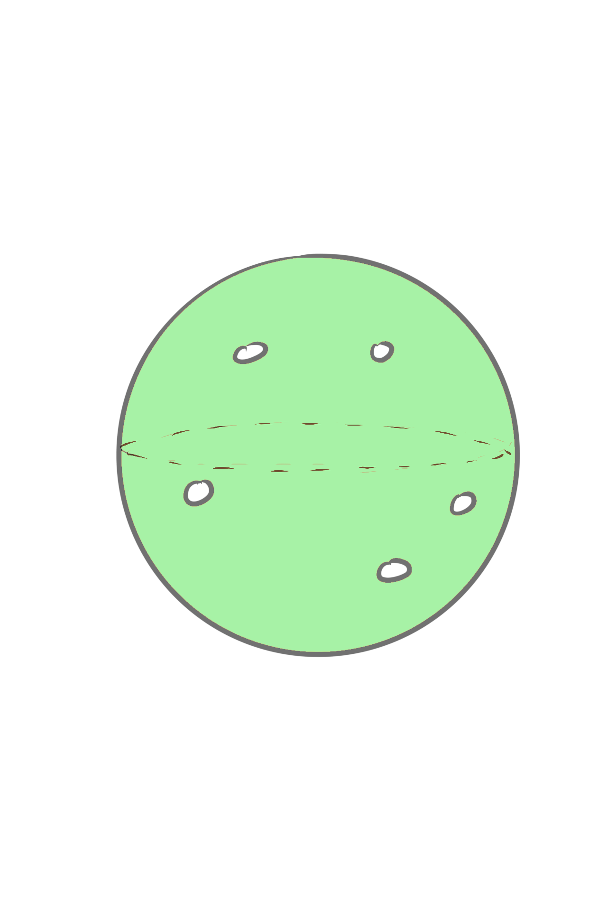
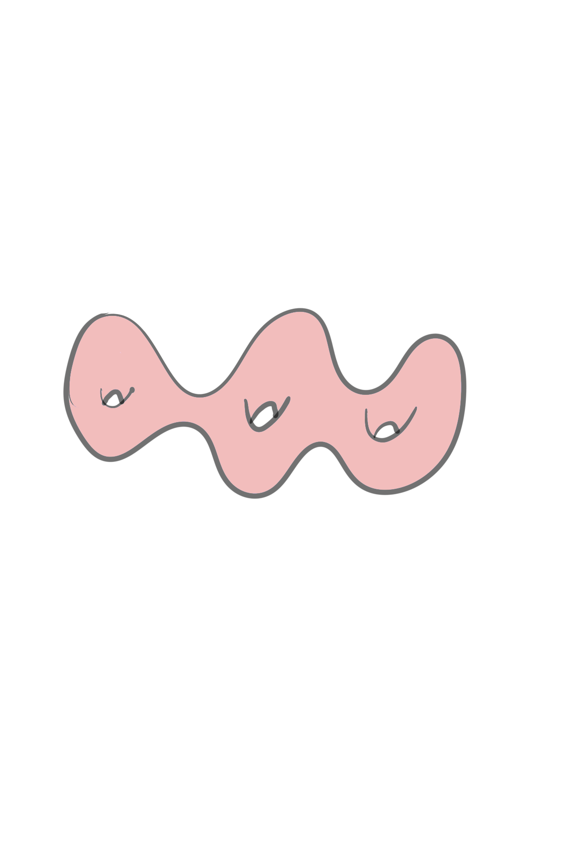
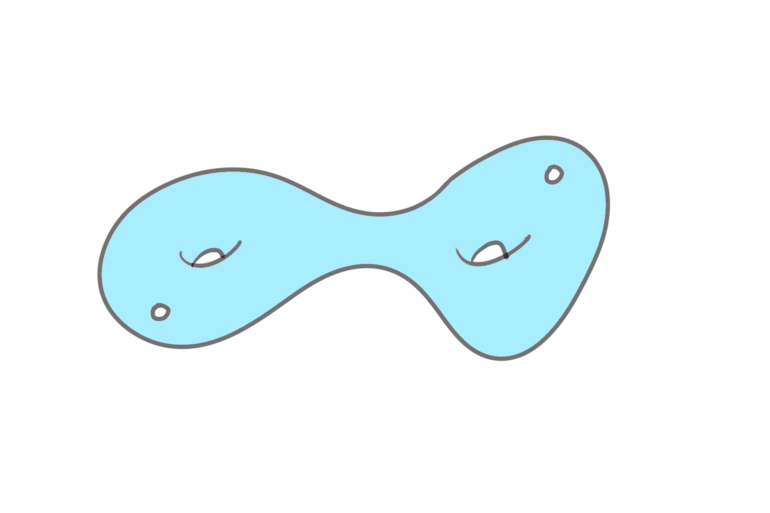
Surfaces
Finite type surfaces with negative Euler characteristic
(Topologically, genus g surfaces with n points removed)

Slide 5
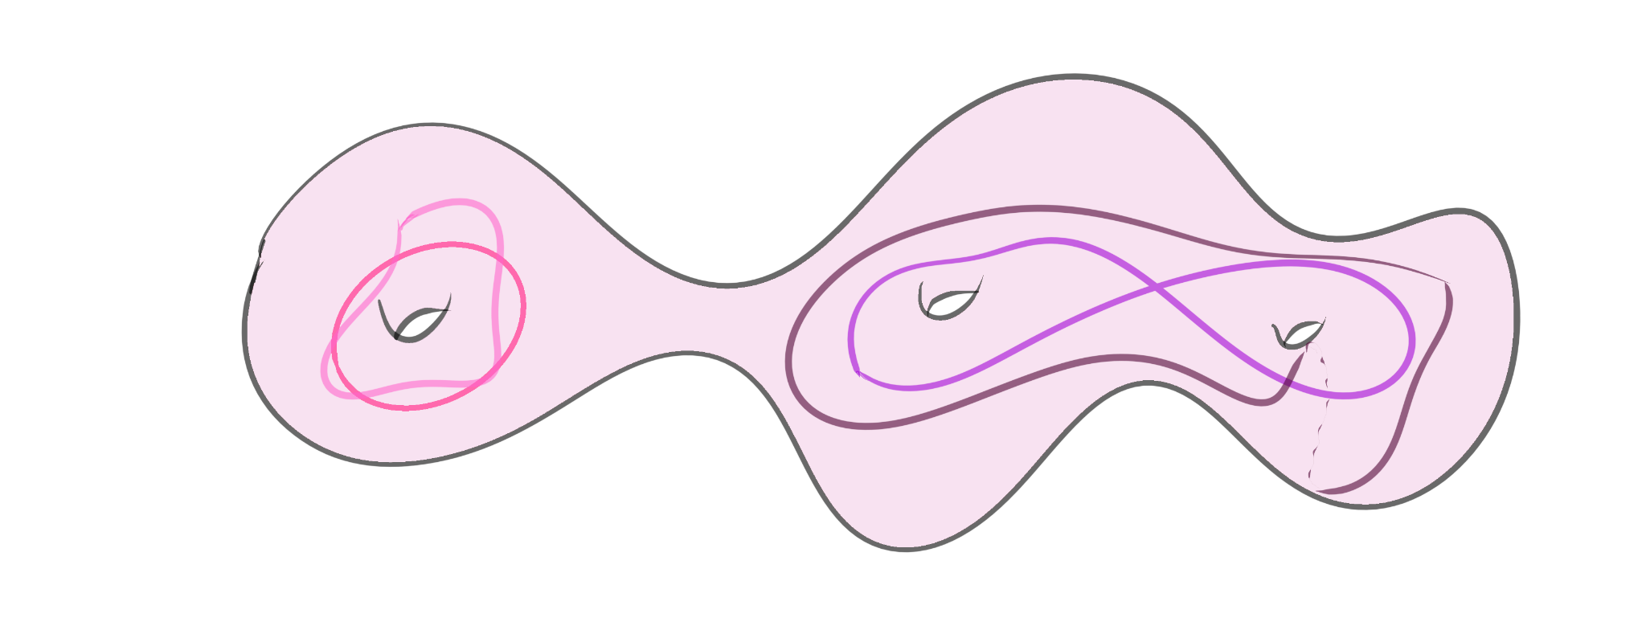
Curves
We will consider all curves up to homotopy class
In each homotopy class there is a unique geodesic (shortest one)
Primitive, essential

Slide 6
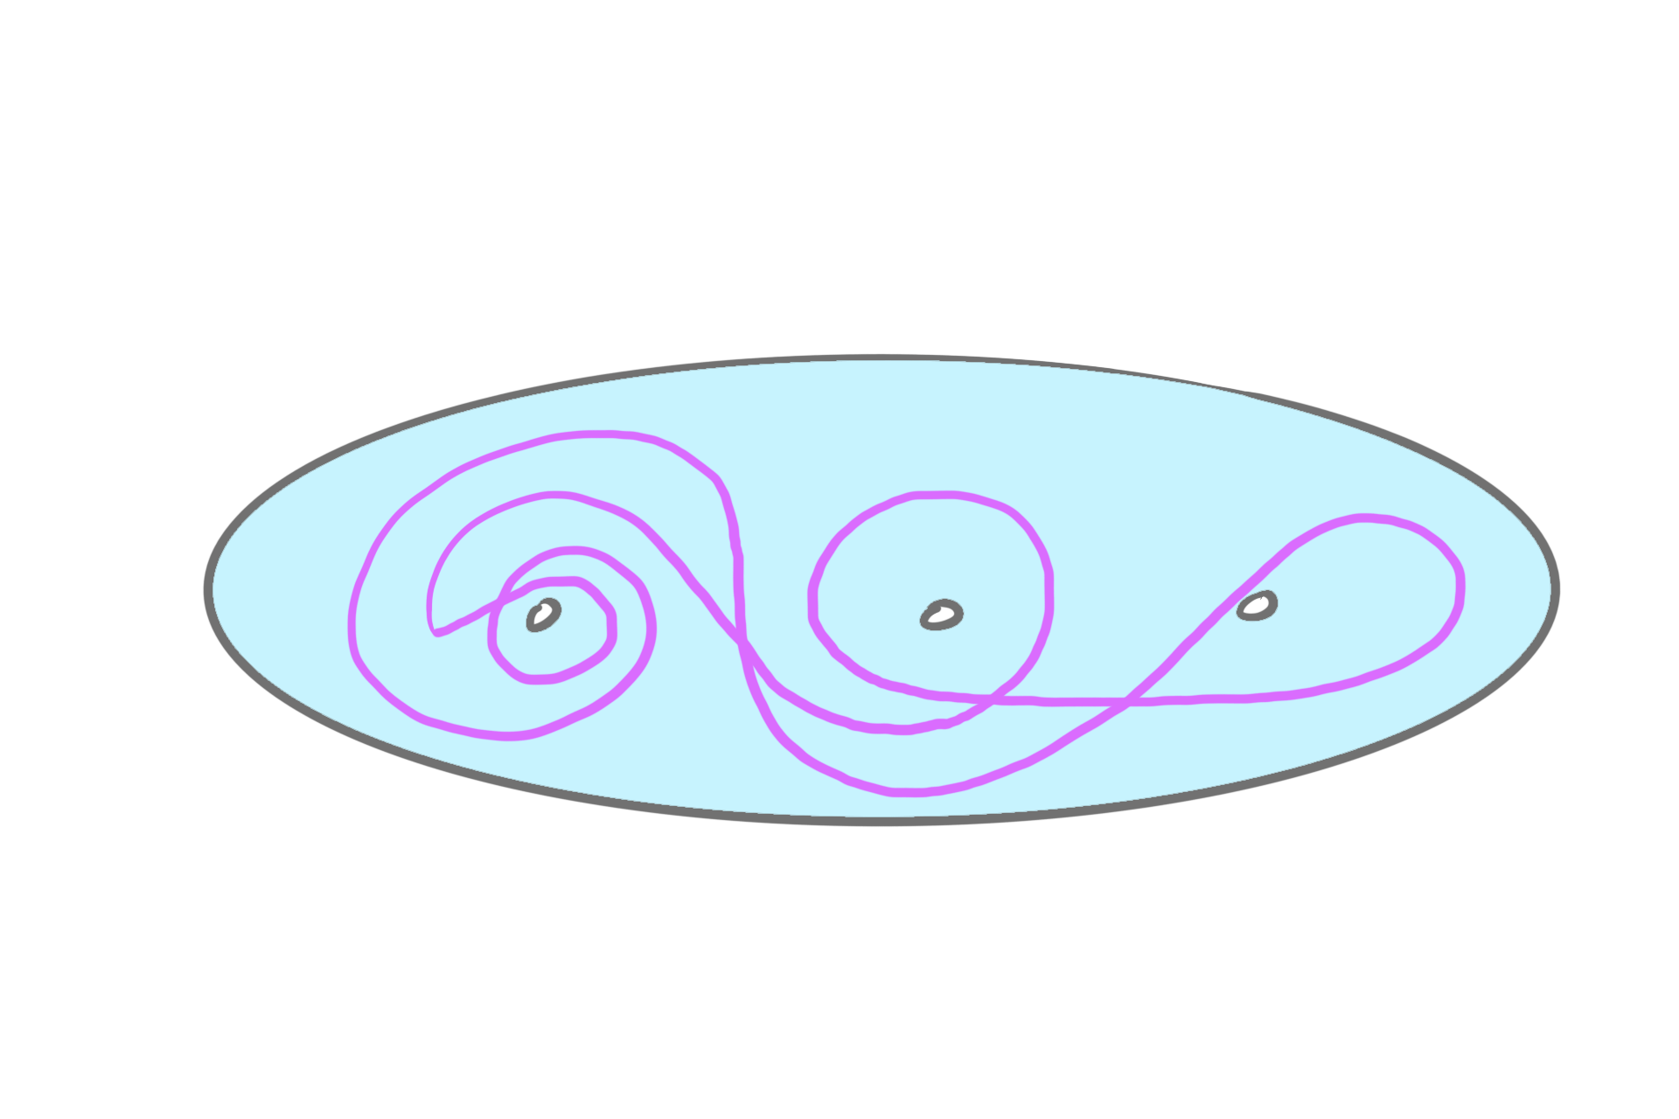
Filling Curves
Example:
Definition: A closed curve on a surface is said to be filling if it intersects every essential simple, non-peripheral closed curve on the surface.
Alternative definition:
Complement of a filling curve is a union of discs and annuli

Slide 7
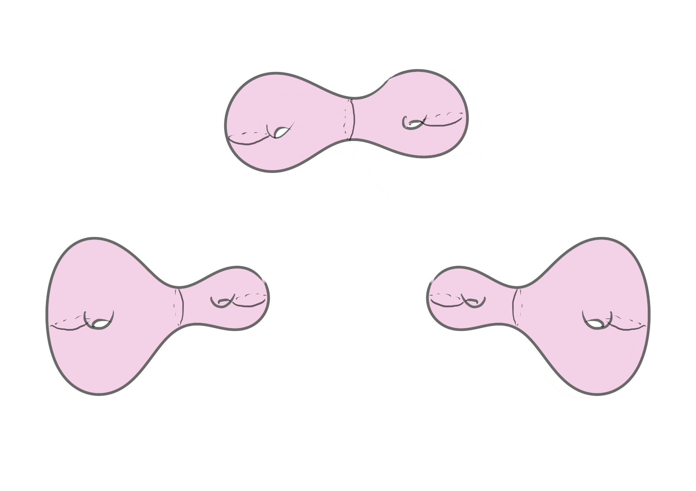
Teichmüller Space
Set of isotopy classes of marked hyperbolic structures.
Each point in Teichmüller space of 𝜮, can be denoted as (X,f ) where X is a surface with complete, finite area hyperbolic structure with geodesic boundary and f is a diffeomorphism from 𝜮 to X.
(X, f) ~ (Y, g) if f o g ⁻¹ is isotopic to an isometry.
3 different points in Teichmüller space

Slide 8
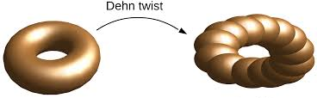
Mapping Class Group
Group of orientation preserving
isometries up to isotopy
MCG := Diffeo ⁺ (𝜮) / ~
f ~ g if f o g ⁻¹ is isotopic to identity
Easy example: Dehn twists
The MCG acts naturally on the Teichmüller space.
g o (X,f) (X, f o g ⁻¹ )
Acts by “unmarking”

Slide 9
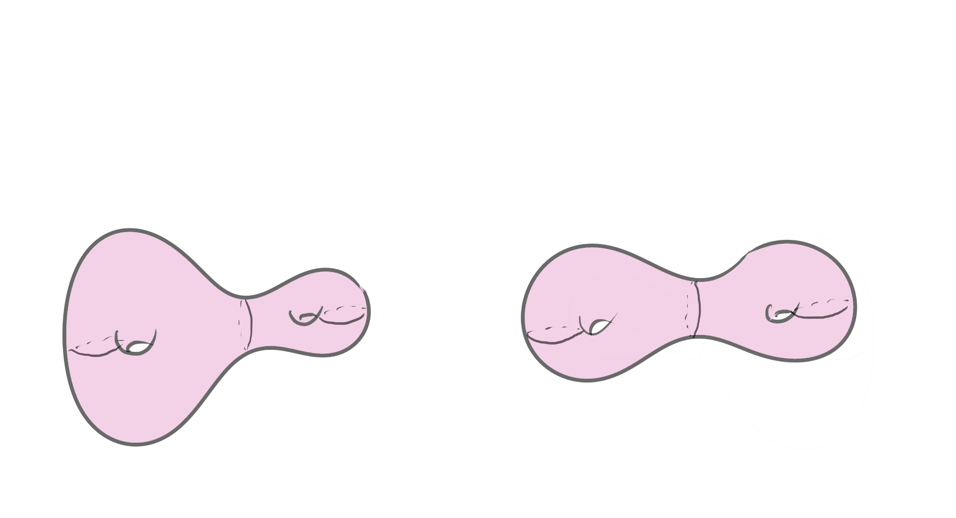
Moduli Space
Moduli space Mg is the quotient of Teichmüller space under the action of MCG.
Two points (X, f) and (X, g) that map to the same point in moduli space differ by the action of the mapping class g⁻¹ ◦ f
3 different points in Teichmüller space
2 different points in Moduli space

Slide 10
Topological Types
Two curves are said to be of the same topological type if there is a mapping class group element taking one to the other.
Different
Same

Slide 11
02
INVARIANTS

Slide 12
Inf invariant
Fix a topological surface 𝚺 and let Teich(𝚺) denote its Teichmuller space.
Consider a non-simple closed curve γ in 𝚺.
For (𝞍,X ) in(𝚺) . Let lᵧ(X) denote the ‘X-length’ of the geodesic in the free homotopy class of 𝞍(γ).
We define the length infimum of γ as follows:
mᵧ = inf { lᵧ(X) : (𝞍, X ) in Teich(𝚺)}

Slide 13
Properties:
Invariant under action on Mapping Class Group on Teichmuller space.
The infimum is attained. (Mumford compactness theorem)
The infimum is unique. (Convexity of Weil-Petersson geodesics)

Slide 14
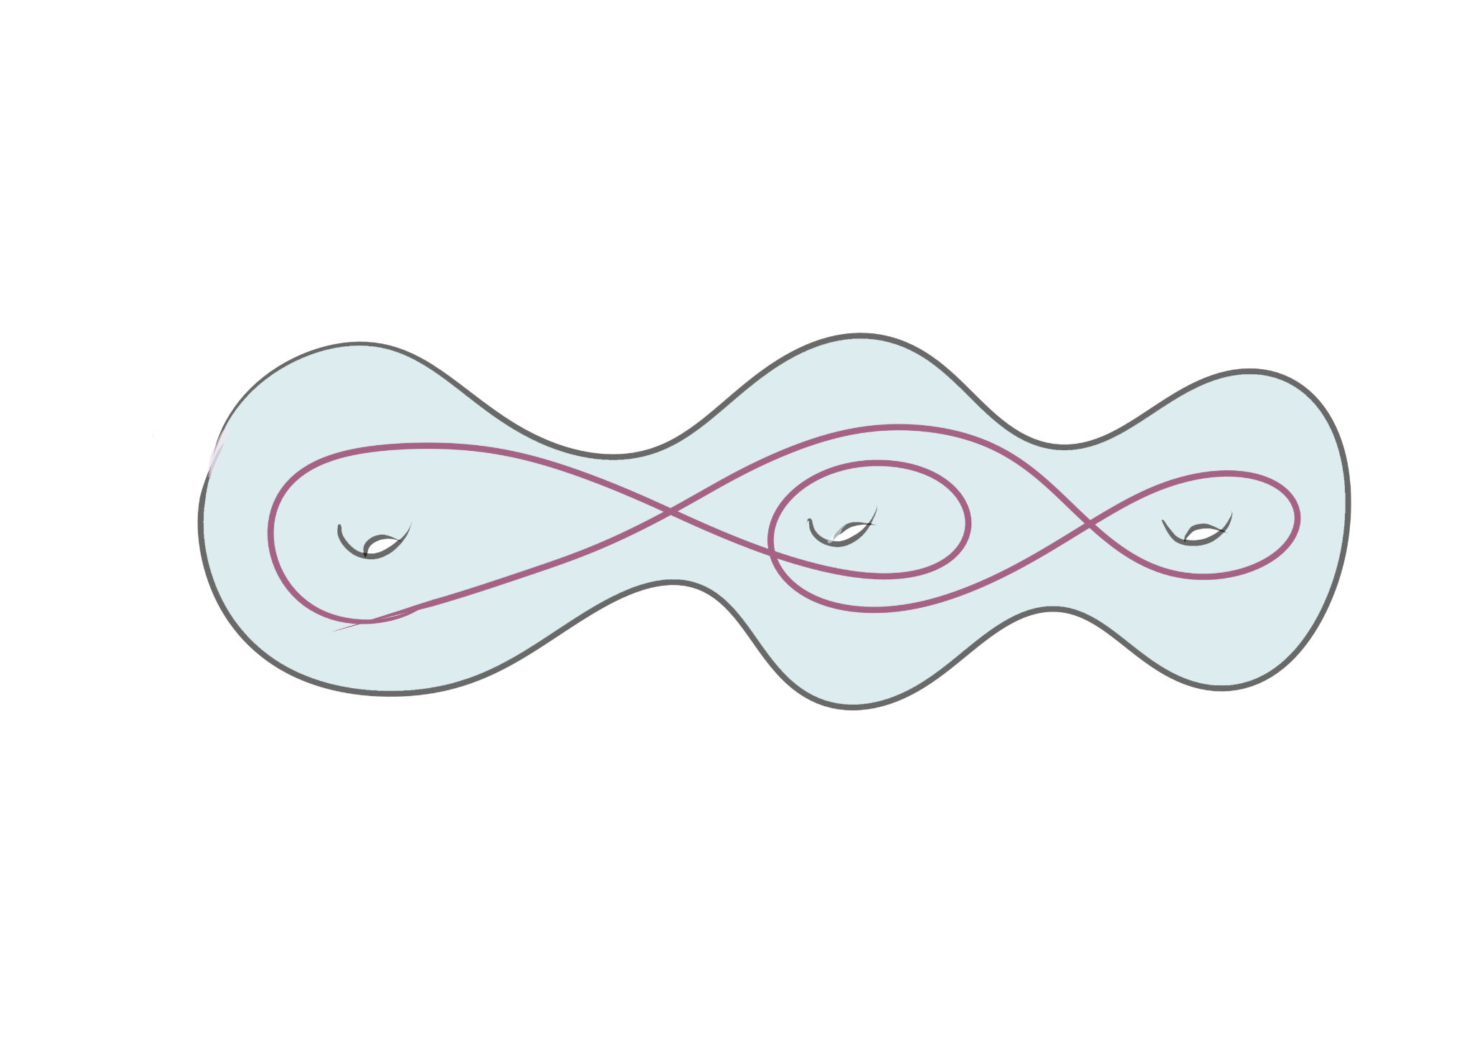
Other invariants
Self intersection number
If γ non-simple closed curve in 𝚺 , then the self intersection number of γ denoted by i(γ ,γ ) is the minimum number of self-intersection points of a curve in its free homotopy class in general position.

Slide 15
03
RELATION BETWEEN INVARIANTS

Slide 16
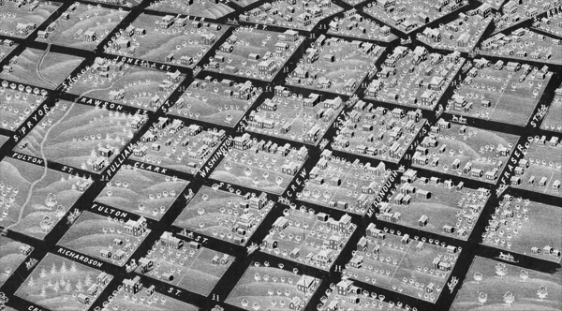
Motivation
Self intersection number vs Length
Want to buy : Self intersections
Currency: Length
To achieve more intersections we would need longer curves.
However, we can get more intersection for less length in thin parts of the surface.

Slide 17
Questions:
Relations between these invariants?
Is the inf invariant a complete invariant? Are there curves with same inf invariant?
Can the inf invariant distinguish curves that the self intersection number can’t?

Slide 18
Known Results:
Length equivalent curves. (C. Leininger, 2003)
Universal length bounds for non-simple closed geodesics on hyperbolic surfaces. (A. Basmajian, H.Parlier, and J.Souto., 2017)
Length bounds on shortest k-geodesics. (A. Basmajian, 2013)
Explicit inf length values for a certain of curves (uniform filling curves). (E. Girondo, G. González-Diez, R.A. Hidalgo, 2023)
For geodesic currents… (J. Sapir, S. Hensel, 2021, 2023)
Length minima for an infinite family of filling closed curves on a one-holed torus.
(Z.Wang and Y.Zhang, 2022)

Slide 19
04
CONSTRUCTING FILLING CURVES

Slide 20
Minimal filling curve
Definition: Filling curve with the minimum self intersection number on a given surface.
For a closed surface of genus g, this curve is unique and has intersection number 2g - 1. (C. Arettines , 2015).
The complement is one disk!
m ᵧ = (4g − 2) arccosh (2 cos[ π/4g−2 ] + 1)
We extend his construction to surfaces with boundaries (genus g and n boundary components).
Intersection number = 2g − 1 + max {0 ,, (n − 1)}
Complement consists of annuli.

Slide 21
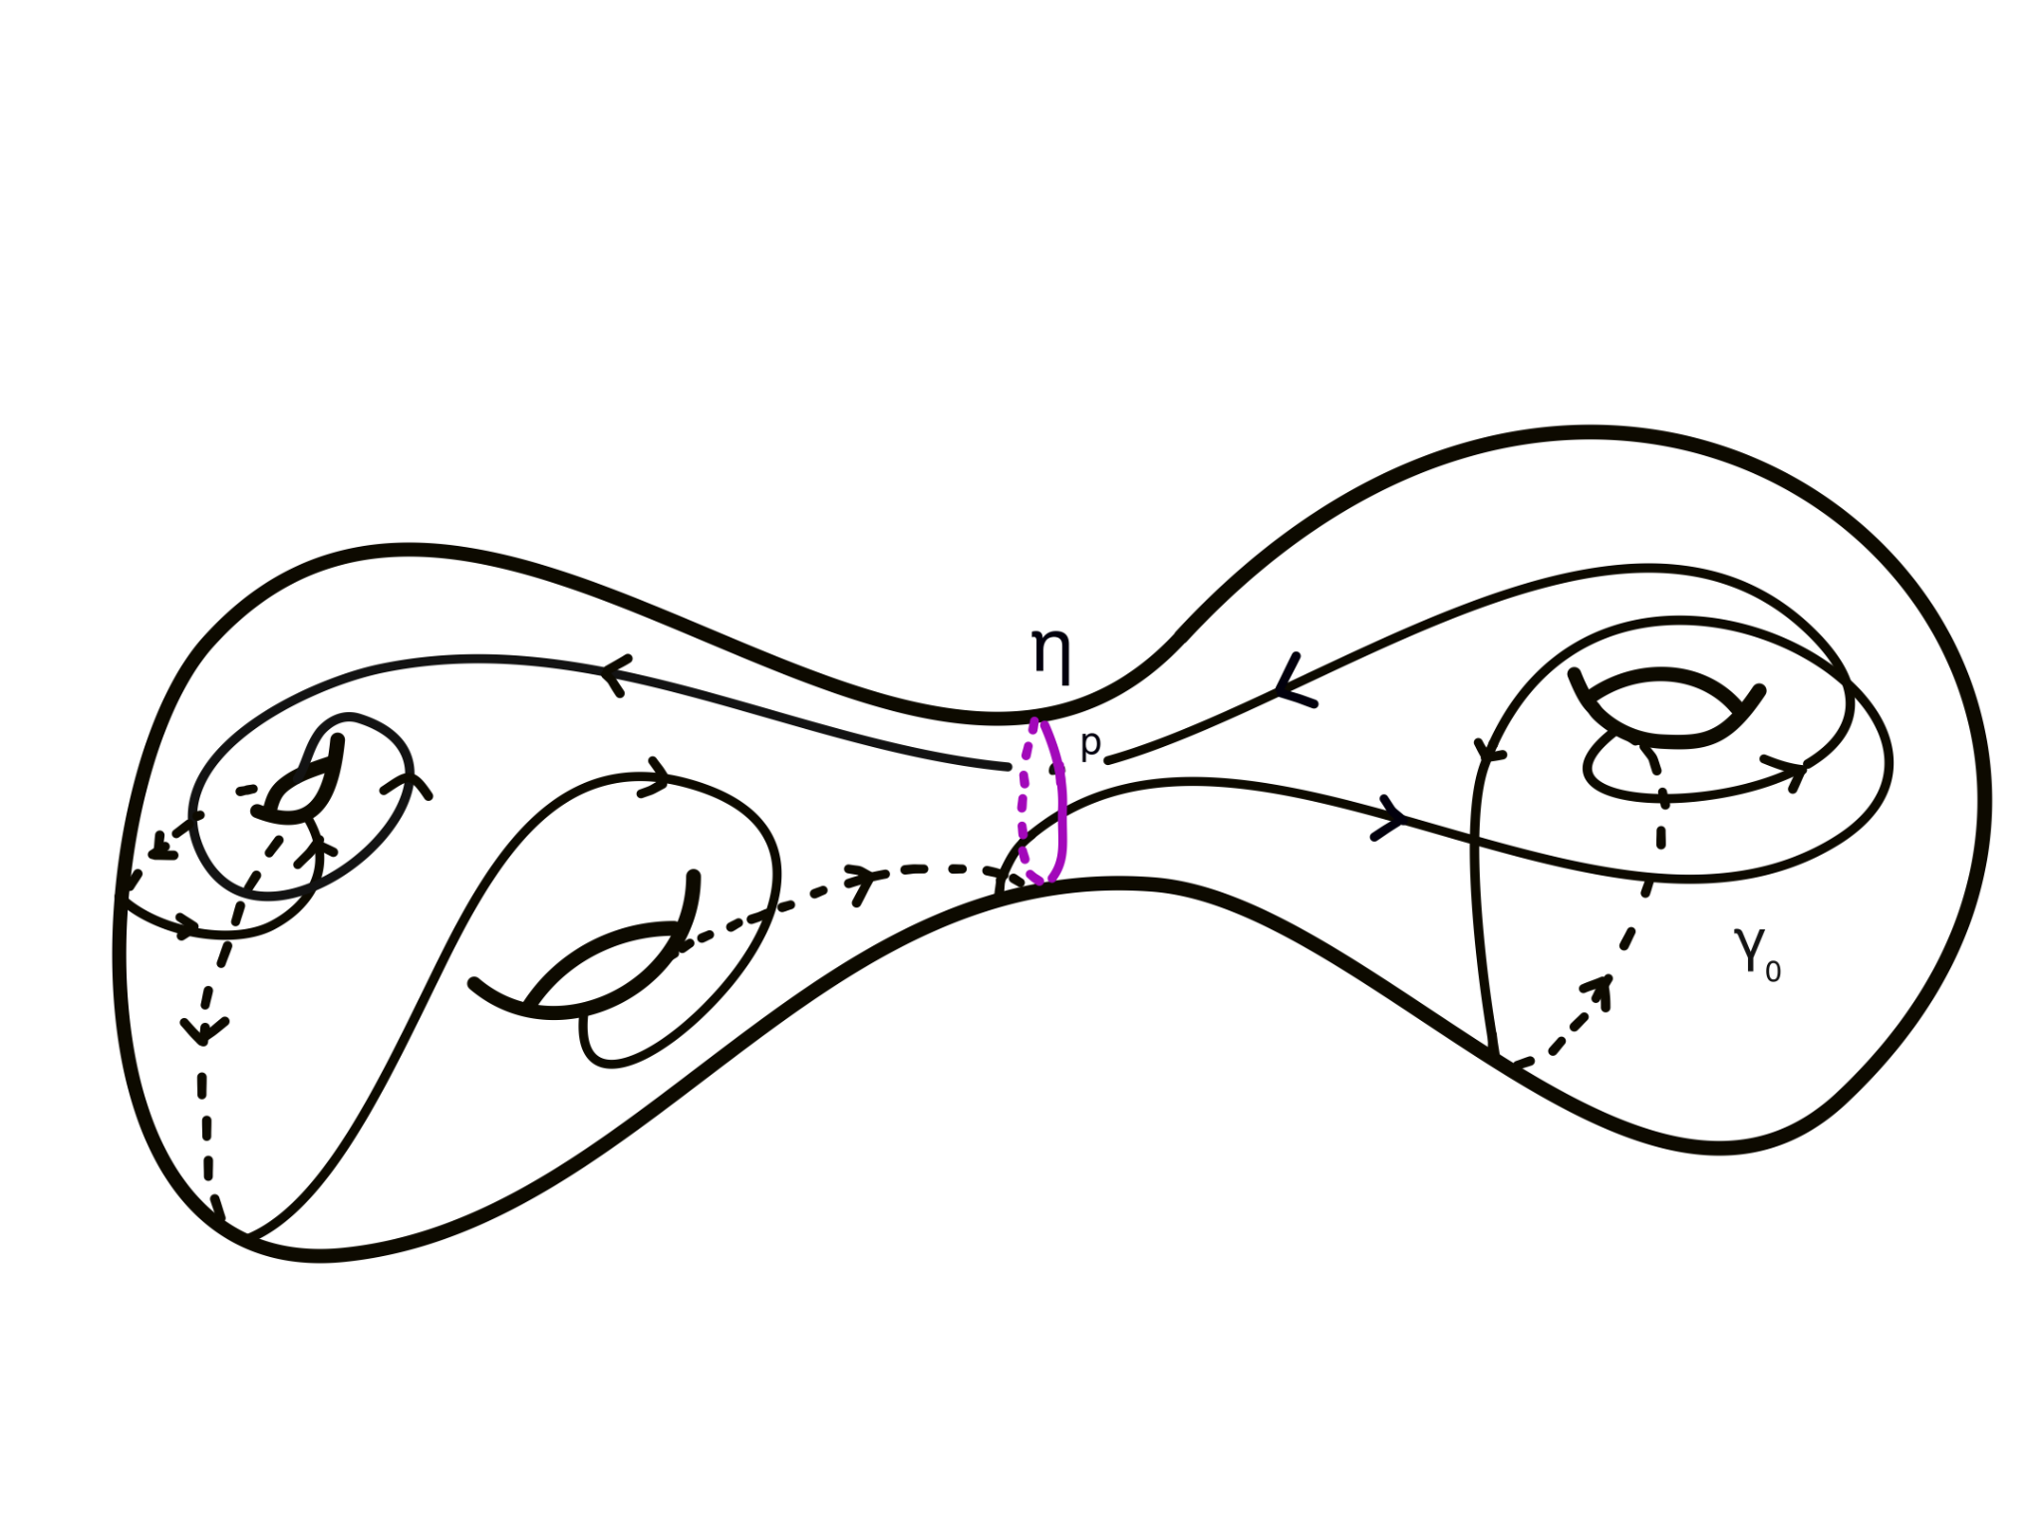
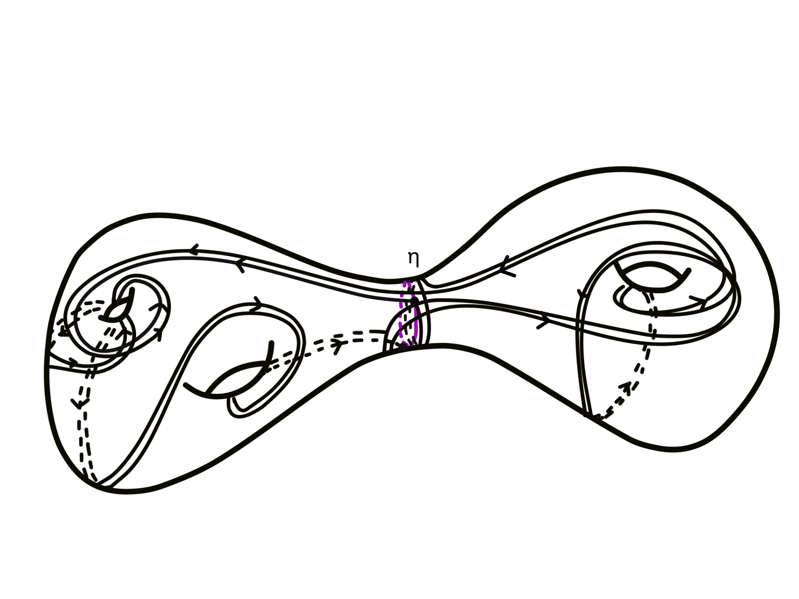
Family 1: Separating Curve Case
Start with a (minimal) filling curve γ₀
Cut at an intersection point with a separating curve.
Given a pair of positive
integers (m, n) , let γ be the curve η^{m} ∗ γ₀^{n}
(based at the intersection point)
A (2,2) curve.

Slide 22
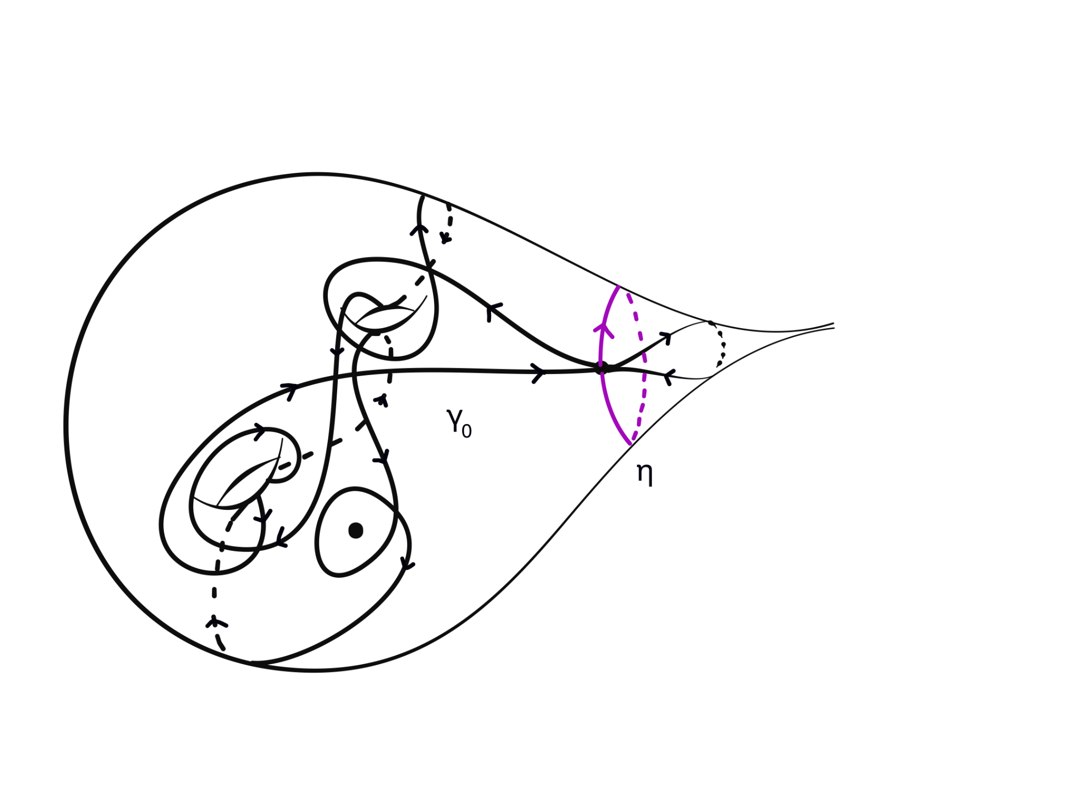
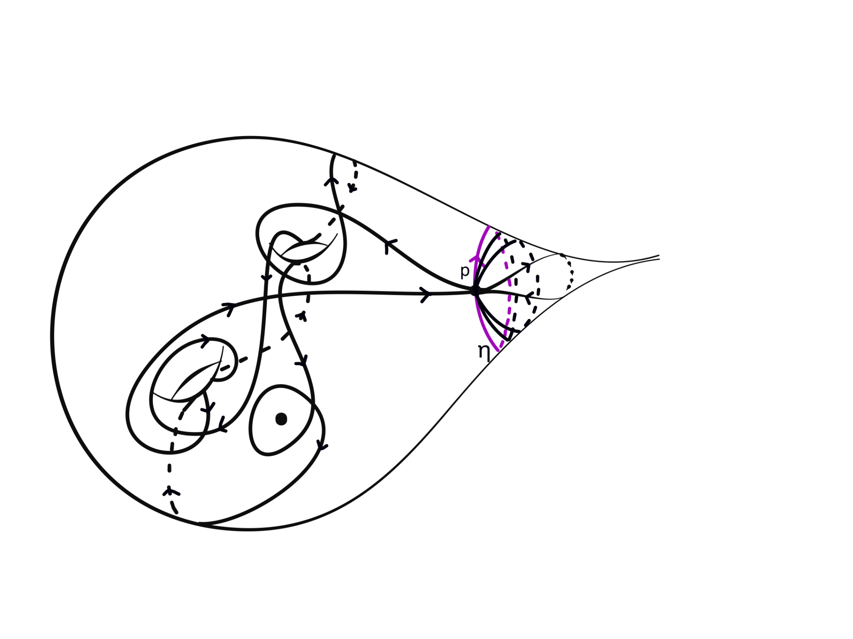
Family 2: Punctured Surface Case
Start with a (minimal) filling curve γ₀, with a subloop homotopic to a puncture.
Start at an intersection point of the subloop.
Given (m, n) , let γ be the curve η^{m} ∗ γ₀^{n} that start at p and goes around γ₀, n times, then around η, m times.
A (2,1) curve.

Slide 23
05
LENGTHS AND INTERSECTION NUMBERS

Slide 24
Self Intersection numbers:
Separating Curve Case:
i(γ, γ) = i(γ₀, γ₀)n² + (i(γ₀, η)n − 1)m
Punctured Surface Case:
i(γ, γ) = i(γ₀, γ₀)n² + m ± 1

Slide 25
Admissible Pairs
β_{k}
For a fixed k = i(γ, γ) where k >> 2g − 1, there are several choices of curves (pairs of integers(m,n)) in both curve family with k self-intersections. We call these admissible pairs.
Separating Curve Case
Punctured Surface Case

Slide 26
Coarse length bounds
Separating Curve Case:
2n [d + r(ℓ_{η}(X)/2]+ mℓ_{η}(X) − C ≤ ℓ_{γ} (X) ≤ 2n [D + 2 r(ℓ_{η}(X)/2))+ Kℓ_{η}(X)] + mℓ_{η}(X)
Constants d, D, and K are independent of n and m, and only depend on γ₀
Punctured Surface Case:
nd + 2 log m − c₂ ≤ ℓ_{γ} (X) ≤ 2 log m + nℓ γ₀(X) + c₁
where c₁, c₂, d are positive constants that depend only on γ₀

Slide 27
06
RESULTS

Slide 28
Theorem 1 (Separating Curve case)
Suppose χ(Σ) ≤ −2. There exists an infinite set of positive integer K and a collection of curve pairs {(α_{k}, β_{k})}, k∊K such that
(1) α_{k} and β_{k} are each filling curves
(2) i(α_{k}, α_{k}) = i(β_{k}, β_{k}) = k
(3) mα_{k} ≲ log k < √k ≲ mβ_{k}
(4) the optimal metrics {Xβ_{k}} are contained in a compact subspace of moduli space.
(5) The metrics {Xα_{k}} limit to a stratum S in ∂M(Σ) which correspond corresponds to η being pinched.

Slide 29
Theorem 2 (Punctured Surface case)
Suppose Σ has negative Euler characteristic with genus g and n ≥ 1 punctures. There exists an infinite set of positive integer K and a collection of curve pairs {(α_{k}, β_{k})}, k∊K so that
(1) α_{k} and β_{k} are each filling curves
(2) i(α_{k}, α_{k}) = i(β_{k}, β_{k}) = k,
(3) mα_{k} ≠ mβ_{k}
(4) mα_{k} ≲ 2 log k < c√k ≲ mβ_{k}
(5) the metrics Xα_{k} and Xβ_{k} stay within a compact subspace of M(Σ) for all k.

Slide 30
Admissible Pairs
β_{k}
For a fixed k = i(γ, γ) where k >> 2g − 1, there are several choices of curves (pairs of integers(m,n)) in both curve family with k self-intersections. We call these admissible pairs.
α_{k}
α_{k}
β_{k}
β_{k}
Separating Curve Case
Punctured Surface Case

Slide 31
Proof Sketch (Separating Curve case)
mα_{k} ≤ 2D + 4 log (m / log m)+ K (log m /m) + log m, where m = (k − 2g + 1)
mβ_{k} ≥ 2d ⌊√(k − 1)/(2g − 1)⌋− C
Thus, mα_{k} ≲ log k < √k ≲ mβ_{k}

Slide 32
Proof Sketch (Punctured Surface case)
mα_{k} ≤ 2 log(k − c − 1) + ℓγ₀ (X) + c₂
mβ_{k} ≥ d√(k − 2)/(2g + p − 2) − c₁
So, mα_{k} ≲ 2 log k < c√k ≲ mβ_{k}

Slide 33
Questions
What about the other curves with k self intersections? (In progress)
Examples of filling curves with same self intersection number and same inf?
Understanding the inf length spectrum . . .

Slide 34
THANKS!
Please keep this slide for attribution

